Slide 1

Power Quality in electrical distribution systems and buildings

Slide 2

Main ideas
Reliable Delivery to homes, buildings and industries with the:
  Right Voltage
  Right Frequency
Consideration of Harmonic Distortion
Higher Sensitivity of Modern Devices

Slide 3

Relevance for engineering professionals
Reliability
Safety
Overvoltage (cause of Photovoltaic Systems)
  The system changes from mono-directional to bi-directional
Energy Efficiency
  With unbalanced Phases energy losses are expected

Slide 4
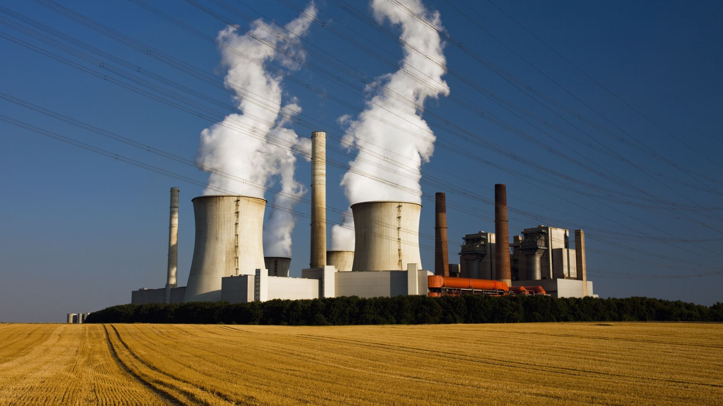
Examples of professional situations
Designing Powerplants
Designing of Substations
Compliance with the Standards
Choosing the right Voltage for Transmission
Choosing the right Transmission type (over head lines or Cables (burried in the Earth))

Slide 5

Similarities and differences in different countries
Finland
high standards in terms of quality
77 Distribution Companies
22 – 23 cents per kWh
Bangladesh
Lower standards in terms of quality
6 Distribution Companies
3,5 - 10 cents per kWh
Austria
high standards in terms of quality
115 Distribution Companies
Mostly 400V and 10kV and 20kV
21 – 29 cents per kWh
Similarities
Voltage and Frequency

